Slide 1
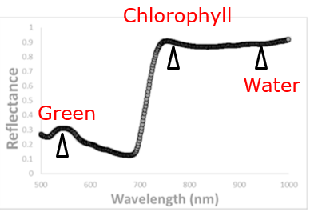
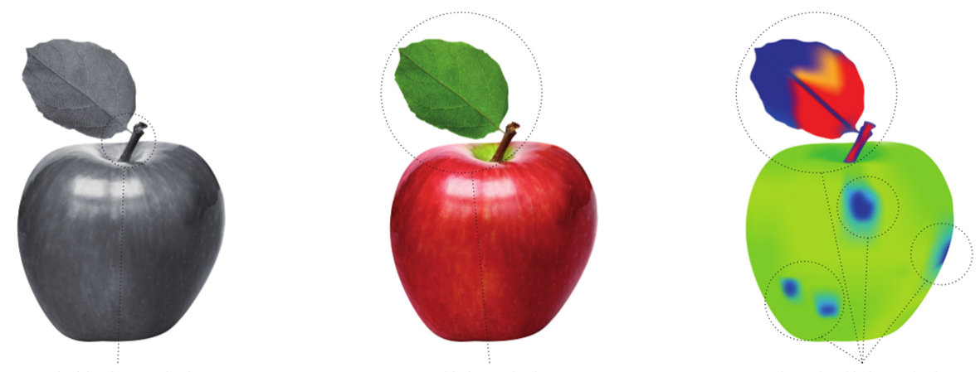
Hyperspectral Phenotyping is Changing the Plant Studies
Hyperspectral imaging has capacity to measure:
Biomass
Leaf Moisture
Chlorophyll Content
Diseases
And More …
Evolution of plant vision
Greyscale Imaging
(1 Band)
Color Imaging
(3 Bands)
Hyperspectral Imaging
(over 100 Bands)
Notes:
Hyperspectral phenotyping is changing the plant studies.
Compared to the traditional imaging technologies like greyscale and RGB, hyperspectral imaging captures hundreds of bands, which enables us to efficiently and accurately measure lots of plant physiological features such as plant biomass, Leaf Moisture content, and Chlorophyll Content.
By now, hyperspectral imaging has been widely used in the current plant phenotyping studies, which largely facilitates the development of new plant seeds and genotypes.

Slide 2
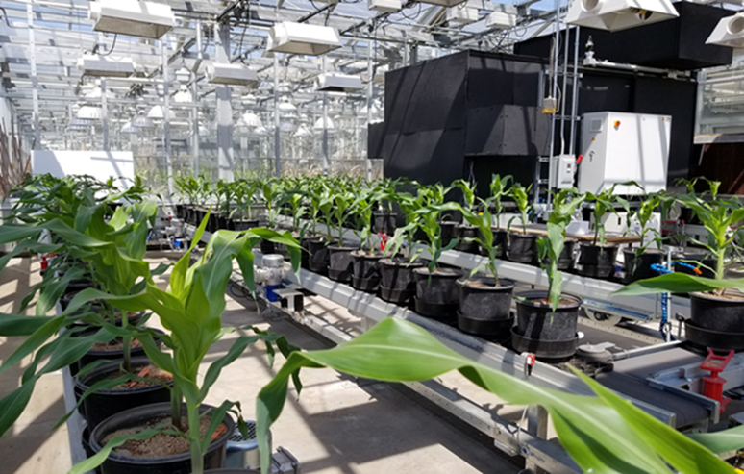
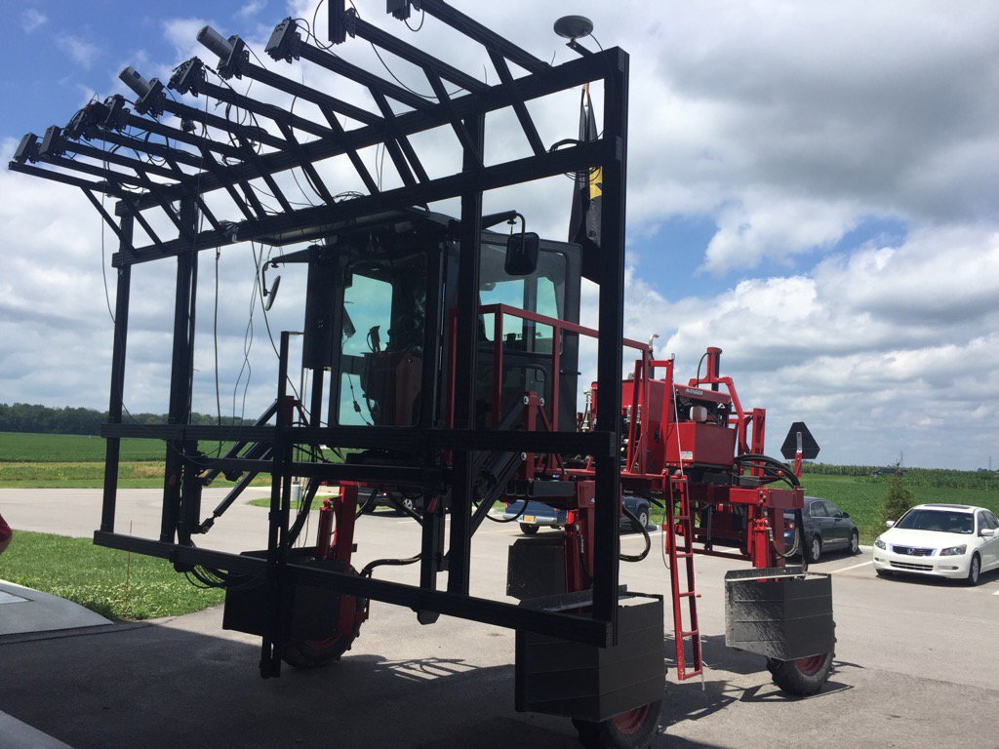
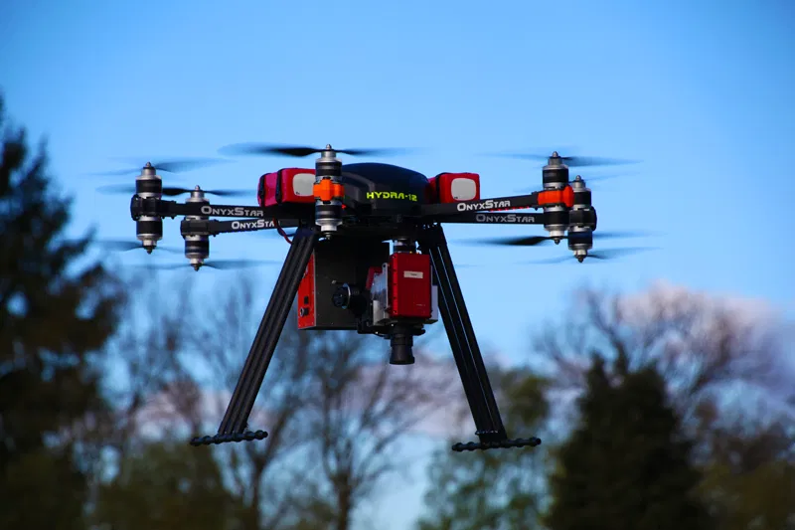
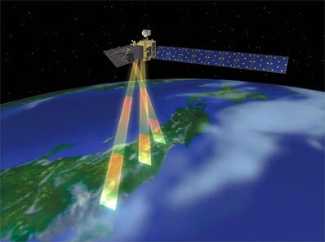
Hyperspectral phenotyping platforms
Indoor Imager
Ground-based vehicles
Unmanned Aerial Vehicles
(UAV)
Satellite
Notes:
Currently, there are various types of hyperspectral imaging platforms such as indoor hyperspectral imager like this imaging tower in the greenhouse. Also we have the ground-based vehicles, the sensors can be mounted on the tractors to image the plants in the field. In the air, we have the unmanned aerial vehicles (UAV or drone). It is one the most popular hyperspectral imaging platforms in the current field studies. Besides that, satellite is also used to collect very large-scale hyperspectral imaging data.
With the rapid development of these advanced imaging technologies and platforms, the hyperspectral imaging on plant phenotyping is more capable and more accurate in analyzing plant features, which largely accelerates the progress of plant breeding studies.
However, the current hyperspectral phenotyping imaging data is still suffering from severe noises, which largely affect its accuracy.

Slide 3
Plant Phenotyping is a War Between Signal and Noise
Micro-climate
Image time
We’re looking for <5% yield improvement signal,
among >200% difference caused by environmental variations
Non-uniform growth environment
Changing leaf angels
Various environmental conditions
Different imaging time
Genotype
difference
Treatment effects
…
Leaf angle
Sun angle
…
Plant phenotyping data
Notes:
Plant phenotyping is a war between signal and noise. Unfortunately, we are looking for less than 5% yield improvement signal for example
among these >200% difference caused by the environmental variations,
such as non-uniform environment in the greenhouse, changing leaf angles during the day, varying environment conditions.

Slide 4
Research Objectives
Reduce the heterogenous microclimate in greenhouse (noise from non-uniform environment)
Greenhouse simulation model (Ma et al. 2019a)
Conveyor system and validation test (Ma et al. 2019b)
Model the environmental impacts on airborne hyperspectral images in field (noise from changing environment)
Diurnal pattern models (Ma et al. 2020a, under review)
ANN calibration model on environmental impacts (Ma et al. 2020b, under review)
Notes:
These are the research objectives for today’s talk. I am going to start with the removal of the heterogenous microclimate in greenhouse focusing on the noise from non-uniform environment.
Followed by modeling the environmental impacts on the airborne hyperspectral images in field, which is about the noise from the changing environment.

Slide 5
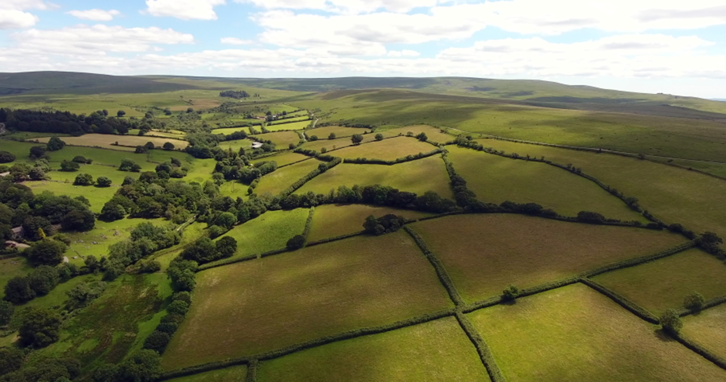
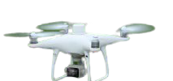
Challenges from Changing Environment While Imaging
An image taken at 10am is going to look very different from one taken at 6pm taken at 6pm
Air temperature (℃)
Solar irradiation (W/m2)
Wind speed (m/s)
Solar zenith angle (degree)
Humidity (%)
Diurnal time (min)
Notes:
Ok. I have so far introduced the removal of microclimate noise in the greenhouse. However, there are more challenges from the changing environment while imaging.
A plant image taken at 10am is going to look very different from one taken at 6pm. It is very important to investigate how the imaging data is impacted by the changing environment.
suffered from problems of uneven reflectance due to shadows cast by cumulus clouds rapidly developing during the mid-summer noontime flights

Slide 6
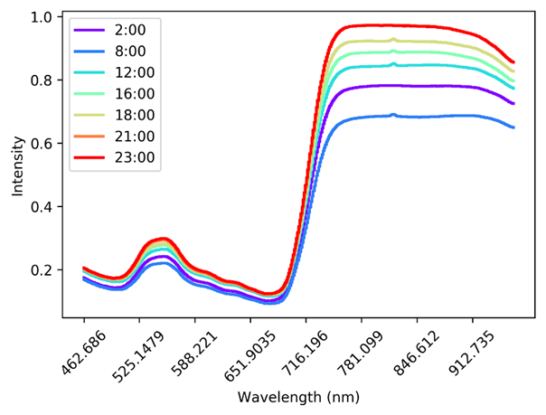
Continuous Imaging Test in the Greenhouse – Result 1
Water Condition
The plant reflectance spectrum has significant changes over time.
The spectra of different imaging time points during one day for the same corn plant: 2:00, 8:00, 12:00, 16:00, 18:00, 21:00, 23:00 on June 16, 2017, respectively.
Notes:
This is the spectral figure for the same corn plant imaged at different time points within the day from this continuous imaging test. Here, x is the wavelength, and y is the reflectance intensity. We can clearly see the changing spectral features from the morning to the night. Please note this is for the same plant imaged under the same lighting condition with same sensor.
So, We can see the reflectance spectrum of plant has significant changes over time.

Slide 7
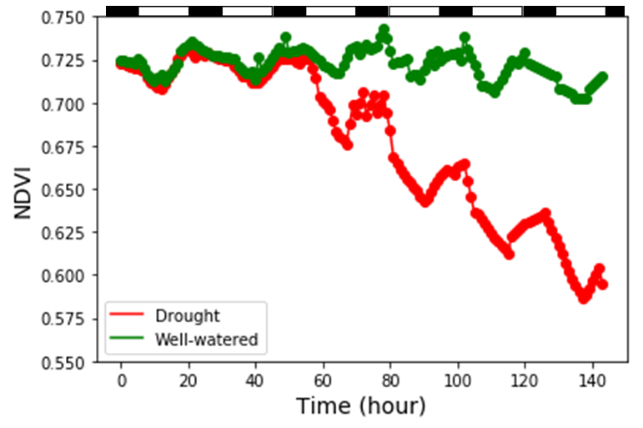
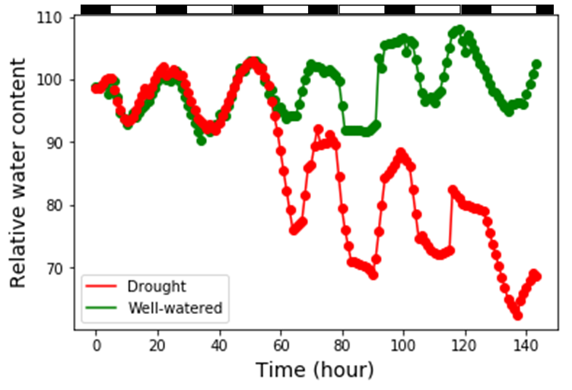
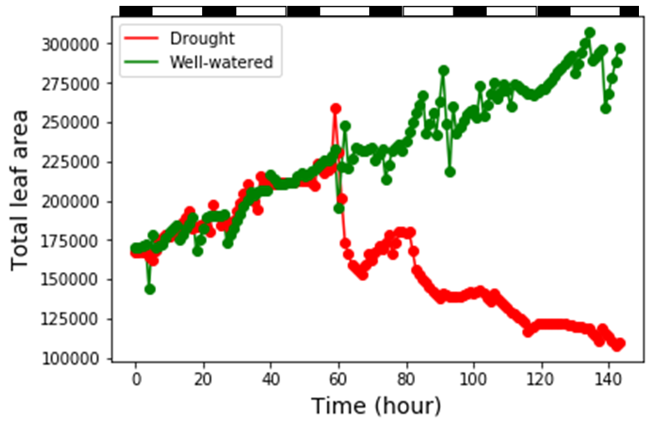
Continuous Imaging Test in the Greenhouse – Result 2
Water Condition
Plant hyperspectral phenotyping features follow periodic changes at a daily frequency.
Notes:
Then, I further calculated the phenotyping features from these hyperspectral imaging data including NDVI, projected leaf area, and the relative water content. I plot them along the timeline for the whole 6 imaging days. The white and black bars on the top of each figure indicate the day and night time.
It is very interesting that we can clearly observe the periodic changes of different plant features on both well-watered and drought stressed plants. Especially for the NDVI and relative water content, it looks like the plant has repeatable decreasing and recovering periods every day.
So, my second finding here is plant hyperspectral phenotyping features follow periodic changes at a daily frequency.
These two findings inspired me to further investigate how the hyperspectral imaging data changes in the field.
Unlike the relatively consistent enviroenmtal condition in the greenhouse, in the field, the environment is continuously changing, and it is uncontrollable.

Slide 8
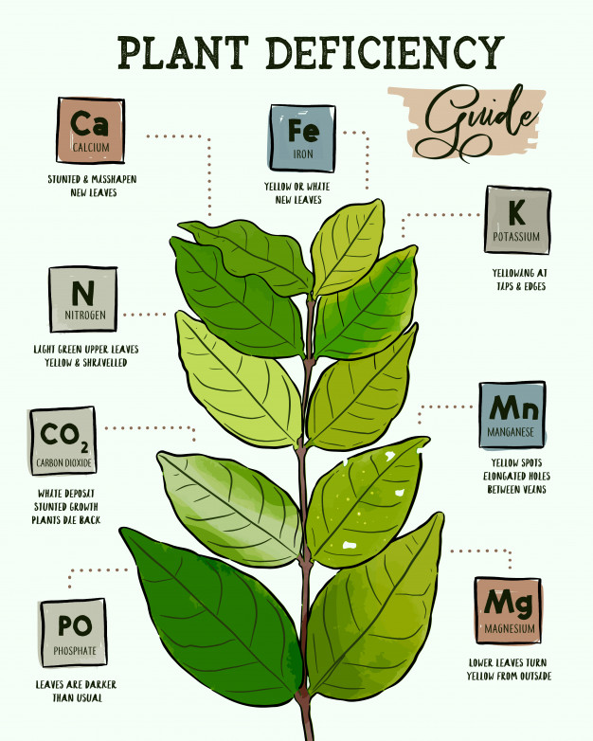
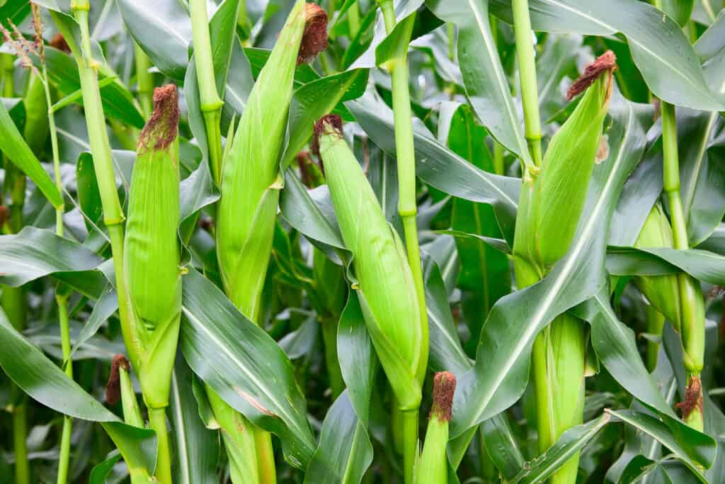
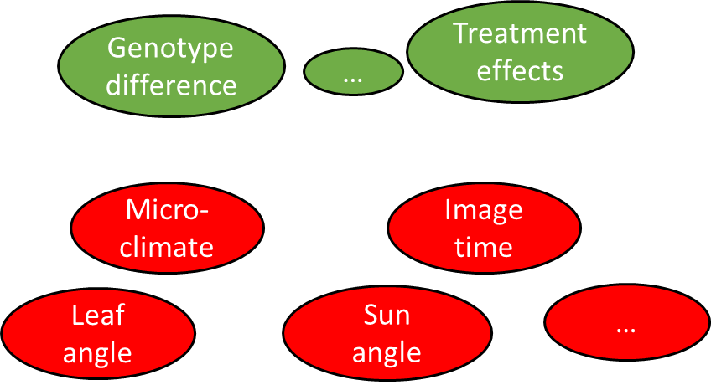
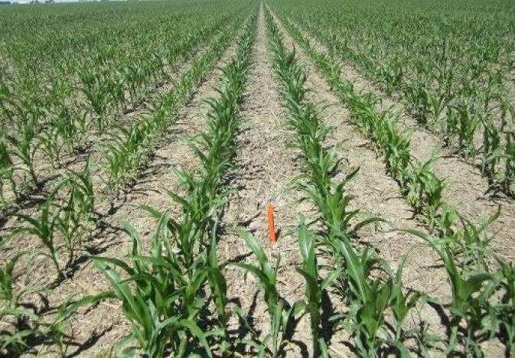
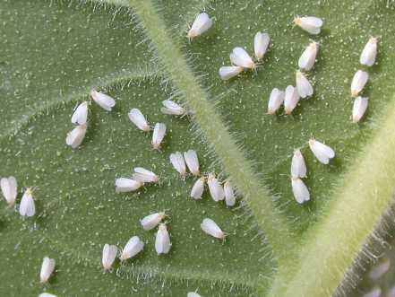
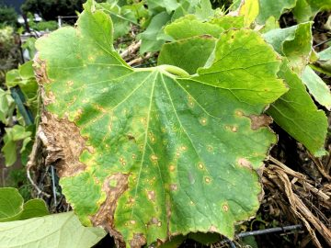
Contributions
Yield estimation
Nutrients level prediction
Drought stress assessment
Disease detection
Chemical injury detection
Notes:
With the reduced noise in the hyperspectral imaging data, the signal will show up for more accurate plant feature analysis such as yield estimation, disease detection. nutrient level prediction, chemical injury detection, and drought stress assessment.
The advancement of current sensing technologies has already enabled us to capture very accurate imaging signal from the plants.
I believe, reducing the noises, especially the noise from the changing environment, can be a more effective way to improve the quality of plant phenotyping.
Reducing the environmental noises in hyperspectral imaging data will be very helpful to increase the accuracy of plant phenotyping studies.
https://www.freepik.com/premium-vector/identifying-plant-nutrient-deficiencies_2754305.htm
https://gardeningfever.com/2018/07/16/22-common-plant-diseases-images/
https://www.agprofessional.com/article/look-drought-stress-north-dakota-corn

